Slide 1
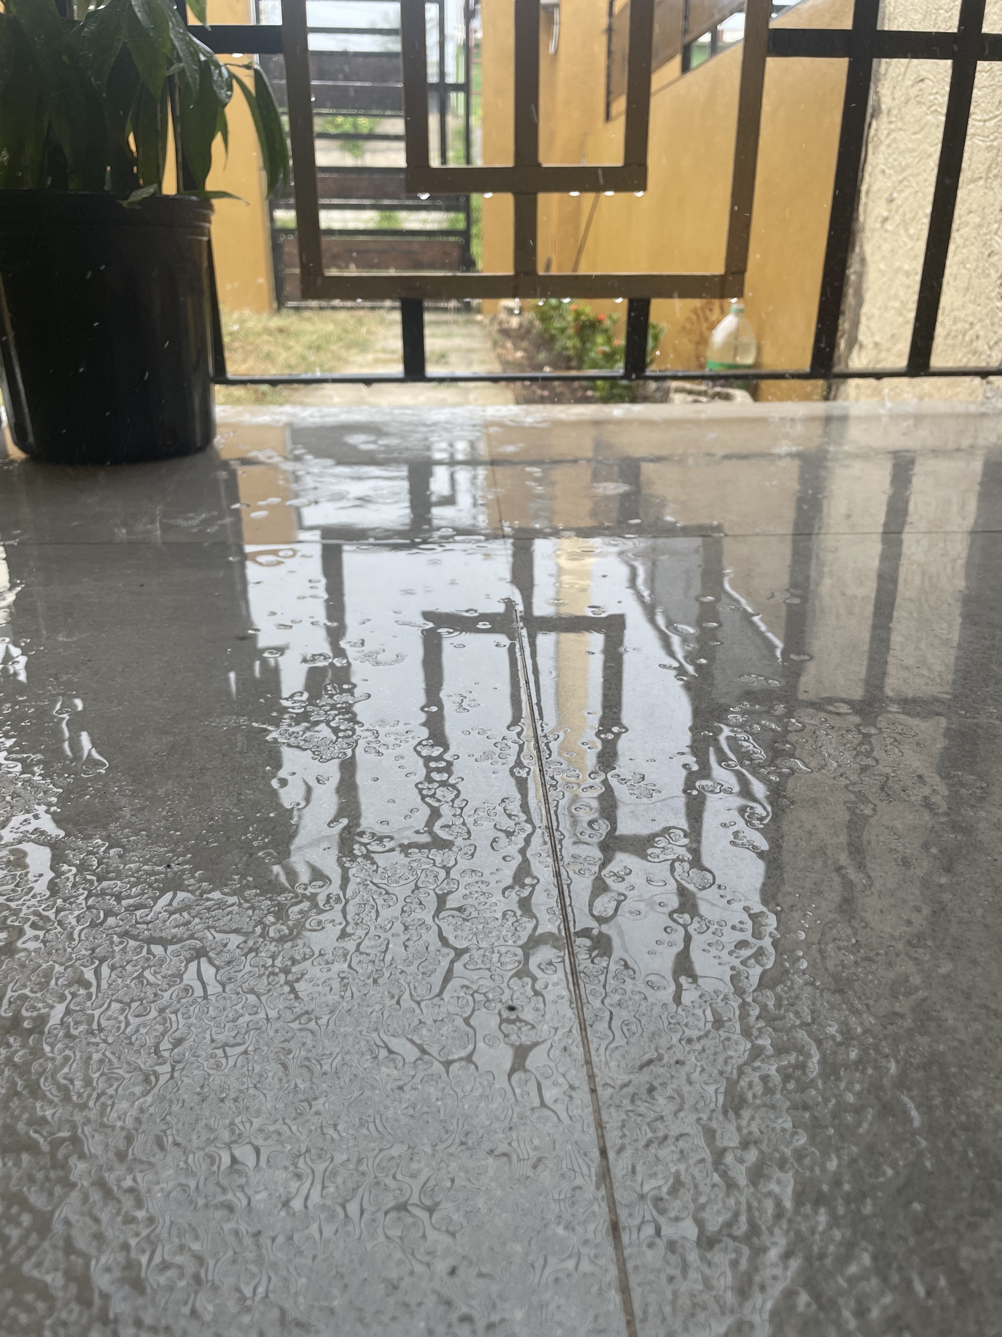
SMART PATIO SHIELD
Predicting wind-driven rain, hour by hour, for a Jamaican veranda
Romayne Grey · M.Sc. Applied Data Science · COMP6830 · UWI
Notes:
Good morning. My project is called Smart Patio Shield, and it started with this photo, which I took at my own house. That's my veranda during a storm. It has a roof, but the sides are open behind a decorative grille. The rain is being driven sideways by the wind, straight through that grille, and you can see the water standing on the floor. I wanted a system that could see that coming and close a screen before it happened. That's what this project is. [STAGE: pause on the photo for a beat before advancing]

Slide 2
THE PROBLEM
Covered on top, open at the sides
An open-grille veranda sheds ordinary rain.
But when wind drives the rain sideways, it blows straight through the grille and soaks everything inside.
By the time you can see it happening, it is already too late to act.
The cost is small each time, but frequent: wet furniture, interrupted meals, spoiled goods, a scramble to react.
2
Notes:
So the problem in plain terms. A veranda like this sheds ordinary rain perfectly well, because rain falls straight down and the roof catches it. What it cannot handle is rain that the wind pushes sideways. That comes through the grille and reaches everything inside. Individually it's a small thing. But it happens often, and the cost adds up: wet furniture, an interrupted meal, stock that has to be moved, a scramble to react. And the real difficulty is timing. By the time you can actually see wind-driven rain arriving, it has already reached you. To protect the space you'd need to know a little in advance, and nobody can stand there watching the sky all day.

Slide 3
THE GAP
Why a weather app doesn't help
Not specific enough
Predicts the wrong thing
A regional “40% chance of rain” says nothing about whether this veranda, in the next hour, gets hit.
What matters here is rain AND gusting wind, together, at one spot. No mainstream service predicts that compound event.
The opportunity: a prediction that is hyper-local, event-specific, and early enough to act on.
3
Notes:
The obvious question is why an ordinary weather app doesn't solve this. There are two reasons. The first is that forecasts are regional. A forty percent chance of rain across Kingston tells me nothing about whether my particular veranda gets hit in the next hour. The second is that they predict the wrong thing. What causes the damage isn't rainfall on its own. It's rain combined with gusting wind, at one specific spot. No mainstream service predicts that combination. So the opportunity is a prediction that's specific to a location, specific to that rain-and-wind event, and early enough to actually act on.

Slide 4
WHAT I BUILT
A nowcaster for wind-driven rain
It looks at the current weather and the last few hours of history, and judges whether this hour is a wind-driven-rain event early enough to deploy a protective screen.
Nowcasting, not forecasting. It assesses the present hour rather than predicting days ahead. I framed it honestly as what it can actually do, and “predict the next hour” becomes clear future work.
Hyper-local
Event-specific
Free data only
4
Notes:
What I built is a nowcaster for wind-driven rain. It looks at the current weather conditions and the last few hours of history, and it judges whether this hour is a wind-driven-rain event — early enough that a protective screen could be deployed. I want to be precise about the word nowcasting. This system assesses the present hour. It does not forecast days ahead, and I don't claim that it does. That was a deliberate decision: I'd rather claim exactly what I can demonstrate. Extending it to predict the next hour is a clear next step, but I haven't done it, so I'm not claiming it. Three principles shaped the design: hyper-local, event-specific, and built entirely on free data.

Slide 5
THE DATA
Structured and unstructured, five years
STRUCTURED
Hourly weather (Open-Meteo / ECMWF IFS, 9 km)
Temperature, humidity, cloud, pressure, wind, plus lag features. The workhorse for Model 1.
UNSTRUCTURED
GOES satellite imagery (infrared + visible)
Pictures of the cloud field over each city. What Model 2 learns from.
CLIMATE
El Niño / La Niña index (ONI)
Seasonal state that shifts Caribbean rainfall.
Kingston and Montego Bay - chosen to capture Jamaica's rain-shadow contrast.
5
Notes:
The data comes from three free public sources, covering five years for two Jamaican cities. The structured half is hourly weather from Open-Meteo, which serves ECMWF's model at about nine-kilometre resolution. Temperature, humidity, cloud cover at three different heights, pressure, wind — and from those I build history features, like what the rain and wind were doing in the previous hours. The unstructured half is GOES satellite imagery: five years of pictures of the cloud field over each city, in infrared and visible light. And a climate index, the ONI, which tracks El Niño and La Niña, because those shift Caribbean rainfall across seasons. The two cities aren't arbitrary. Kingston sits on the dry southern side, in the rain shadow of the mountains. Montego Bay is on the wetter northern side. That contrast is real — Montego Bay is about ninety-one percent wetter — and it forces the model to learn that location matters.

Slide 6
METHODOLOGY
CRISP-DM, end to end
The project traverses the full data science process, not just the modelling step.
Business
understanding
Data
understanding
Data
preparation
Modelling
Evaluation
Deployment
A veranda that floods in wind-driven rain; the decision is deploy or stow.
Five years, two cities. EDA on the diurnal cycle, rain shadow, ENSO.
Free APIs, cleaning, feature engineering, strict chronological splits.
Three models: tabular, vision, and fusion.
PR-AUC on held-out data; every negative result explained.
A working inference service, demonstrated live.
Course requirements met: structured AND unstructured data, relatively large (87,648 hourly records and 87,648 satellite patches) · three trained models · deployed system with live demonstration
6
Notes:
Before the results, a word on method. I followed CRISP-DM, and the project covers the full data science process rather than just the modelling step. Business understanding: a veranda that floods, and a decision to deploy or stow. Data understanding: five years, two cities, and exploratory work on the daily rain cycle, the rain shadow, and ENSO. Data preparation: free APIs, cleaning, feature engineering, and strict chronological splits. Then three models, evaluation on held-out data, and a deployed system. And to address the course requirements directly: the data is both structured and unstructured, and it's large — roughly eighty-seven thousand hourly records and the same number of satellite patches. Three models were trained. And there's a deployed system, which I'll demonstrate live in a few minutes.

Slide 7
THE TARGET
What counts as a “wet-veranda event”
rain > 0.1 mm AND gusts > 15 km/h OR rain > 1.0 mm
An honest note I disclose upfront: at these thresholds the label is almost the same as “did it rain,” because during rain-hours here the wind is nearly always gusting above 15 km/h anyway. It agrees with a plain rain indicator about 99% of the time.
I document this with a sensitivity table rather than hiding it. For the veranda, rain with typical gusting is exactly the damaging case.
7
Notes:
This is what the system actually predicts. A yes-or-no label for each hour, which I call wet veranda. An hour counts as yes if there's at least light rain and the wind is gusting, or if the rain is heavy enough on its own that wind doesn't matter. Now I want to disclose something before anyone has to ask me. At these thresholds, this label is very close to simply "did it rain." It agrees with a plain rain indicator about ninety-nine percent of the time. The reason is meteorological. During rainy hours in Jamaica the wind is nearly always gusting above fifteen kilometres an hour anyway, so the wind condition rarely changes the answer. I documented that with a sensitivity table rather than leaving it buried. It doesn't break the project — for a veranda, rain with typical gusting is exactly the damaging case — but the honest description is that this is close to a rain detector, and I'd rather say that myself than have it found.

Slide 8
THE APPROACH
Three models, one honest question
Same question: will this hour be a wet-veranda event?
Answered three ways, so I could measure how much each data source really adds.
Model
Uses
Test PR-AUC
In plain terms
Model 1
Weather data (XGBoost)
0.756
The strong, practical predictor
Model 2
Satellite imagery (CNN)
0.440
Real, but weak alone
Model 3
Both, fused
0.741
Fusion — did NOT beat Model 1
The headline finding: the weather-only model is best, and adding satellite imagery did not improve it.
8
Notes:
I built three models. The course requires at least three, but there's a real reason for these particular three: they let me measure how much each kind of data actually contributes. Same question — will this hour be a wet-veranda event — answered three ways. Model one uses the weather data. Model two uses the satellite imagery. Model three combines them. The score is PR-AUC. In plain terms it measures how well the model finds a rare event; higher is better, and the random floor here is about zero point one, because only about nine percent of hours are wet. So model one at zero point seven-five-six is roughly seven times better than chance. And you can already see the headline in that table: the weather-only model is the best one, and adding satellite imagery did not improve it. I'll spend the next few slides on why.

Slide 9
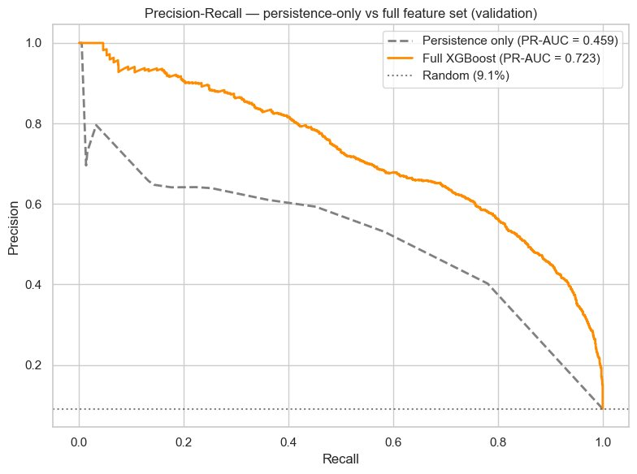
MODEL 1
The tabular workhorse - 0.756
An XGBoost model on the weather features. Test PR-AUC 0.756 (0.709 excluding Hurricane Melissa) - about seven times better than chance.
Persistence vs. real skill.
“Did it rain last hour” is the top feature. But a persistence-only baseline scores 0.459 - so persistence is ~58% of the skill, and the engineered features add the other ~42%: genuine anticipation of rain that is just beginning.
Persistence confirms rain already falling; the engineered features anticipate onset.
9
Notes:
Model one is an XGBoost model on the weather features, and it's the strong performer: zero point seven-five-six on the held-out test set, or zero point seven-oh-nine if I exclude the Hurricane Melissa week. I report both, deliberately. Melissa fell inside my test period and it's an extreme, easily-predicted event worth about five points on the headline. So the honest steady-state figure is the seven-oh-nine, and the seven-five-six includes a storm the system is precisely designed to catch. Neither one is hidden. Now, the single biggest input is whether it rained in the previous hour — about forty-two percent of the model's decision weight. Which raises the obvious challenge: is this model just saying the weather will continue? So I measured it. A model using only prior-hour rain scores zero point four-five-nine. The full model scores well above that. So persistence gives me roughly fifty-eight percent of the achievable skill, and the engineered features supply the other forty-two. And that forty-two percent is the part that matters, because it's what lets the model flag rain that's just beginning — which is exactly what a screen has to do.

Slide 10
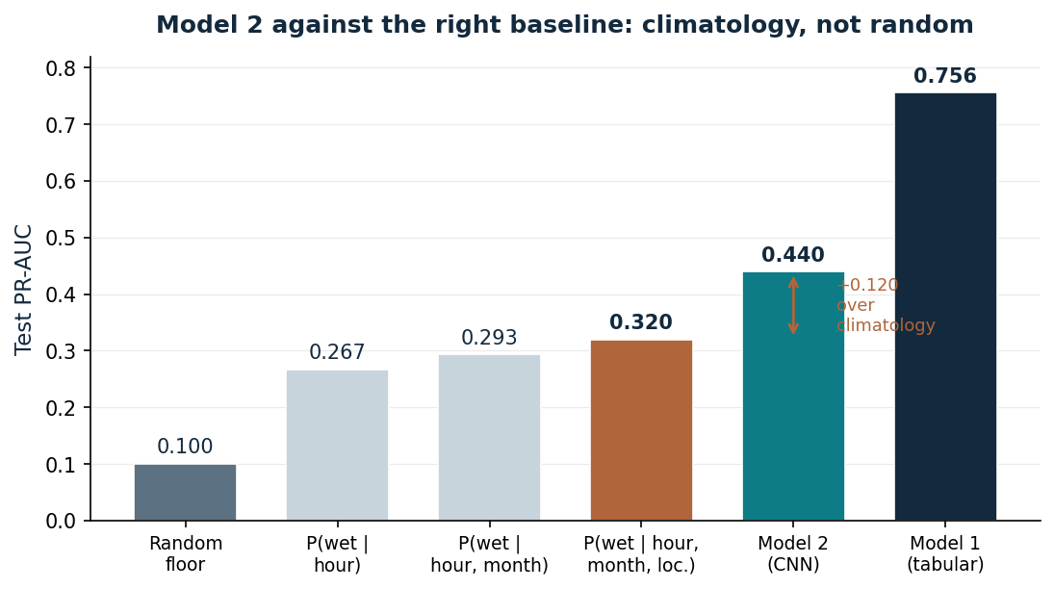
MODEL 2
Satellite vision - against the right baseline
A ResNet-18 CNN on the satellite patches scores 0.440. Weak on its own - but the fair comparison isn't random chance.
The right baseline is climatology.
Rain has a strong daily and seasonal rhythm, so the honest floor is “knowing the hour, month and location” (0.32), not a coin flip (0.10). The CNN's genuine margin is +0.12 over climatology — real signal, but modest.
+0.12 over a climatology lookup — the honest measure of the vision model.
10
Notes:
Model two is a convolutional neural network on the satellite images — a ResNet-18, started from a version already trained on general photographs and then adapted, because there isn't enough satellite data to train something that deep from scratch. It scored PR-AUC of 0.44. On its own that sounds weak, and the interesting part is how you judge it fairly. The tempting comparison is random chance, at zero point one-oh, which would make this look like a big win. But that's not the right floor. Rain here has a very strong daily rhythm — the chance of a wet hour swings about seventeen-fold between six in the morning and two in the afternoon. So a model can score respectably knowing nothing but the hour, the month and the city. That climatology lookup scores zero point three-two. Which means the honest measure of what five years of imagery contributed is plus zero point one-two, not plus zero point three-four. Real signal, but modest. I'd rather report the smaller, correct number.

Slide 11
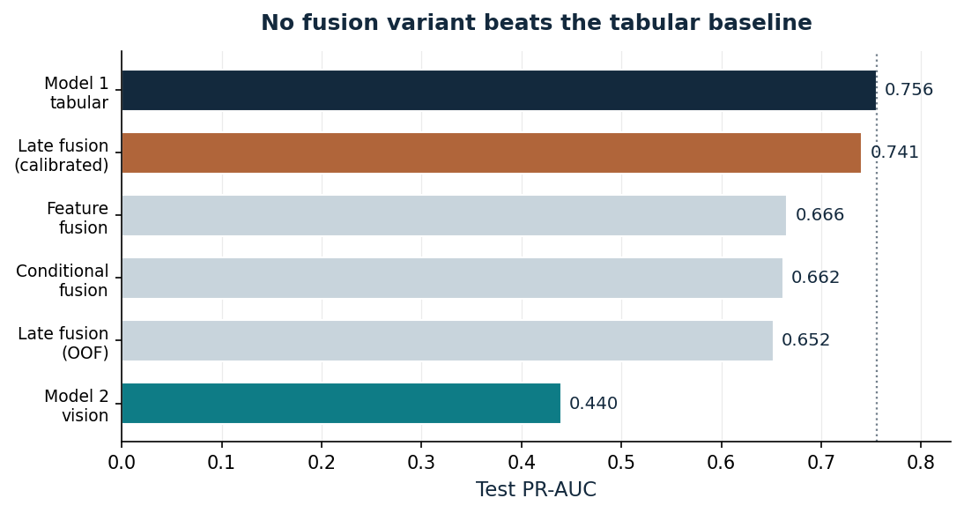
MODEL 3 — THE KEY FINDING
Fusion did not beat the tabular model
Tested five ways
- None beat Model 1 (best fusion 0.741 vs 0.756).
Why? The satellite is conditionally useful.
It beats the weather data only for heavier convective rain (>~2 mm/h). But ~74% of events are light rain; exactly where infrared is blind. Its real advantage covers a small minority of events and washes out overall.
11
Notes:
This is the central finding of the project, so I'll slow down. Fusion means combining the two models. The premise is sound: they see the weather in completely different ways, so their mistakes should differ, and combining them should cover each other's blind spots. It didn't work. No combination beat the weather model alone. The best fusion result is zero point seven-four-one against model one's zero point seven-five-six. And I tested it five separate ways specifically so that a disappointing result couldn't be blamed on a lazy method — raw blending, calibrated blending, combining at the feature level, out-of-fold stacking, and a version built specifically to exploit the satellite's strengths. The important part is that I can explain why. The satellite isn't redundant — that would be the easy explanation and it's wrong. It's conditionally useful. It beats the weather data, but only for heavier convective rain, above about two millimetres an hour, where storms have the tall cold cloud tops that infrared sees clearly. The problem is that about seventy-four percent of my events are light rain — exactly the regime where infrared is essentially blind. So the satellite's real advantage covers a small minority of cases, and it washes out completely when you average across everything.

Slide 12
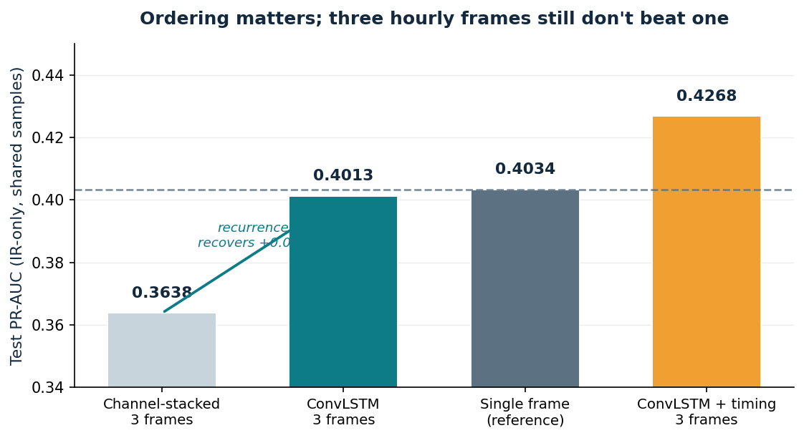
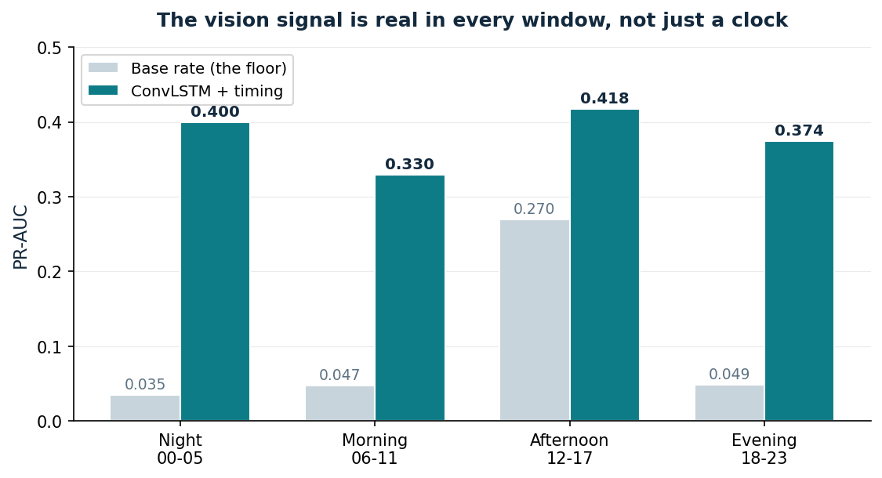
TEMPORAL CONTEXT
Storm motion: tested three ways
A single snapshot can't see a storm moving. I stacked consecutive hourly frames — performance fell. But stacking discards order: the network can't tell which frame came first. So I retrained with a ConvLSTM, which carries state across frames.
Recurrence recovered most of the loss
(0.364 → 0.401), so part of the earlier decline was the mechanism, not the imagery. But it still doesn't beat a single frame (0.403). Three hourly frames add nothing over one.
Adding explicit timing helped further
(0.427) — not the direction expected from a control. Time of day is genuinely informative and infrared can't infer it.
12
Notes:
A single snapshot can't see a storm moving, and storms do move. So giving the model consecutive frames seemed like an obvious improvement. I tried it three ways. First I stacked consecutive hourly frames as extra channels. Performance got worse, not better — zero point four-oh-three with one frame, down to zero point three-six-four with three. But stacking has a flaw: it throws away order. The network sees six image layers with no idea which one came first. So I retrained using a ConvLSTM, which processes frames in sequence and carries a memory forward. That recovered most of the loss — three-six-four back up to four-oh-one. So part of the earlier decline was the method, not the imagery. But notice it still doesn't beat a single frame at four-oh-three. Three hourly frames add nothing over one. Then the third test, which surprised me. Because rain has that strong daily rhythm, I gave each frame explicit markers of its own time of day, as a control — to stop the model gaining from timing rather than motion. It improved the model, to zero point four-two-seven. That's not the direction you expect from a control. It means time of day is genuinely useful information that infrared can't convey on its own. And the chart at the bottom right is the honesty check: scored within four separate time windows, the model beats the local base rate in every one, and by the widest margin overnight. So it isn't just learning the clock. The reason hourly frames aren't enough is physical: at trade-wind speeds a storm cell crosses the whole image within an hour. Real motion needs sub-hourly scans.

Slide 13
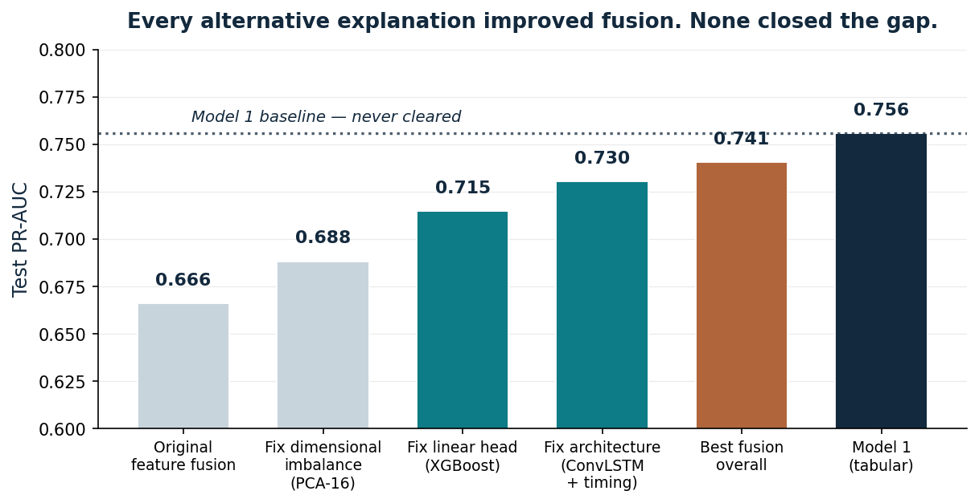
TESTING THE NEGATIVE
Four ways fusion could have been wrong
A null result is only credible if the obvious explanations are ruled out rather than assumed. Each was tested. Each produced a real improvement. None closed the gap.
Scale mismatch
already handled
Linear joint head
+0.05
512 vs 35 features
+0.02
Lost frame order
+0.04
Best result still 0.741 vs 0.756
13
Notes:
Now, anyone can say fusion didn't work. The fair question is whether I tried hard enough, or made a mistake somewhere. So I tested the four ways I could have been wrong. First, that the two data types were on different numeric scales. My supervisor raised exactly this. Standardisation was already there, so that wasn't the cause. Second, that the combining model was linear, while model one's strength is non-linear. Replacing it with a gradient-boosted head gained about five points. Third, that five hundred and twelve image dimensions were swamping thirty-five weather columns. Compressing the image side gained about two points. Fourth, that stacking frames destroyed their time order. The ConvLSTM gained about four. So every single fix produced a real improvement. And not one of them reached model one. That's what moves this from "fusion didn't work" to "fusion can't work here, and here are the four things I checked before concluding it." It's a much harder position to argue with.

Slide 14
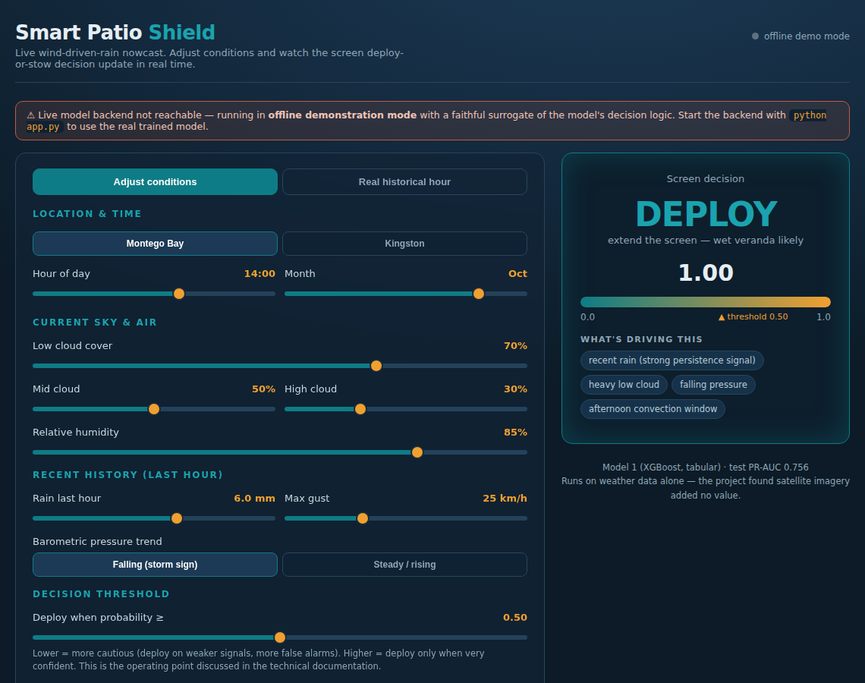
DEPLOYMENT
Deploy the model the evidence supports
The deployed system runs Model 1 alone - weather data only, no satellite pipeline.
This isn't cutting a corner. Since satellite imagery added no value, deploying it would add cost and complexity for nothing. Acting on my own finding gives a lightweight service: no satellite feed, no GPU.
Cheaper to run
Simpler to license
The live inference console next.
14
Notes:
So what did I actually deploy? Model one alone. Weather data only, no satellite pipeline. I want to be clear that this isn't cutting a corner — it's acting on my own finding. Since the satellite added no predictive value, shipping it would mean paying for bandwidth, storage and computation for no benefit. So the deployed service is light: no satellite feed, no specialised hardware. That's a commercial advantage as well as a technical one. It's cheaper to run and simpler to license than a multimodal system would have been. What you're looking at is the live inference console, and rather than describe it, let me show you.

Slide 15
LIVE DEMO
The inference console - real model, live conditions
Move the conditions · watch DEPLOY / STOW update · then a real storm hour
15
Notes:
[STAGE: switch to the browser. Confirm the status dot reads "live model connected" in teal before you start talking.] This is running my actual trained model — the dot in the corner confirms it's connected to the live service, not a mock-up. So let's start with conditions that are fairly calm. You can see the decision reads STOW: keep the screen in. Now I'll increase the rain in the previous hour. Watch the decision. It flips to DEPLOY, the probability climbs, and underneath it tells you what's driving the call — recent rain, heavy low cloud, gusty wind, the afternoon convection window. That's the model explaining itself. Now this slider is the decision threshold, and I want to flag it because it's a business decision rather than a modelling one. Lower it and the system becomes more cautious — it deploys on weaker signals, but you get more false alarms. Raise it and it only acts when very confident. Where you set it depends on whether a missed wetting or an unnecessary deployment costs you more. Let me also switch the location. Same conditions, but Kingston instead of Montego Bay — and the probability drops. The model learned the rain-shadow effect: the southern side is drier. Finally, the more convincing test. This tab loads real hours from the held-out test set, which the model never saw during training. I'll pick a storm hour... and there's the prediction, alongside what actually happened. And here's a calm dry night — correctly stowed. One thing I'd say honestly: a single live prediction is an illustration, not evidence. The evidence is zero point seven-five-six across more than thirteen thousand held-out hours. This just shows that measured skill turning up in practice. [STAGE: switch back to the deck]

Slide 16
LIMITATIONS, HONESTLY
What I'm upfront about
Target ≈ rain detector
The wind clause rarely binds at 15 km/h; disclosed with a sensitivity table.
Nowcasting, not forecasting
Assesses the current hour; longer horizon is future work.
Two locations
A proof of concept; each new site needs local calibration.
Light-rain ceiling
The hardest events to call; satellite, the obvious help, doesn't resolve it.
16
Notes:
Before I close, I want to name my own limitations, because I'd rather state them than be asked. The target is close to a plain rain detector — the wind clause rarely binds at fifteen kilometres an hour. I document that with a sensitivity table. It's a nowcaster, not a forecaster. It assesses the current hour, and longer lead time is future work. It covers two locations. That's a proof of concept, and a new site would need its own calibration. And there's a light-rain ceiling. The hardest events to call are the lightest ones, and satellite imagery — the obvious thing that should have helped — doesn't resolve it. Every one of these is documented, and each has a concrete path forward.

Slide 17
IN ONE BREATH
The negatives are the contribution
A free-data weather model predicts wind-driven rain well
— 0.756 PR-AUC, about seven times chance.
Satellite imagery, tested thoroughly, does not improve it
— infrared is blind to the light rain that dominates, and the four alternative explanations were tested and eliminated.
So I deployed the model the evidence supported.
17
Notes:
So, to draw it together. A model built on free, public weather data predicts wind-driven rain well — zero point seven-five-six, about seven times better than chance. Satellite imagery, tested five ways, with four alternative explanations ruled out, does not improve it. And I can tell you exactly why: infrared is blind to the light rain that makes up three-quarters of these events. So I deployed the model my evidence supported. I'd argue the negative results are the real contribution here. Each one came from a controlled experiment, and each one has a physical mechanism behind it. That's a more useful outcome than an unexplained win would have been — and it's what let me build a product that's lighter and cheaper than the one I set out to build.

Slide 18
Thank you
Questions welcome
Romayne Grey · Smart Patio Shield · COMP6830
Notes:
Thank you. I'm happy to take questions. [STAGE: breathe. Let them ask. Answer the question actually asked, not the one you prepared for. If you don't know something, say so and say what you'd do to find out — that's a stronger answer than a guess.]

